Slide 1
Customer Segmentation & Purchase Behavior Analysis
4
Checkpoint 4 — Final Defense
BED 106 — Business Analytics | Mini Capstone Final Defense
Jeziel Lea Mitch Credo • Nicka Hinlayagan • Jennilyn Manatad
Instructor: Jessie A. Melendres | Talibon Polytechnic College | A.Y. 2026–2027, 1st Semester
Notes:
Whole group on screen. Jeziel opens. Timing: 20–25 minutes total — intro 2–3, data & SQL 3–4, statistics 3–4, live dashboard 5–6, predictive 4–5, ethics 1–2, Q&A 5.

Slide 2
The problem: all customers treated alike
1
Speaker: Jeziel
Three business questions
The business problem
A UK online gift retailer markets and stocks as if all customers were alike — so marketing spend is untargeted, best customers are not specifically retained, and returned products go unflagged.
1
Who are the most valuable customers?
2
Which products and countries drive revenue?
3
What gets cancelled or returned most?
Jeziel Lea Mitch Credo
Project Lead / BI Developer
Nicka Hinlayagan
Data Engineer
Jennilyn Manatad
Statistician / Modeler
Notes:
Cues (say in your own words): the business, what goes wrong without segmentation, the 3 questions, who did what. Data: UCI/Kaggle Online Retail sample, 1–3 Dec 2010, 300 invoices, 207 customers. Keep to 2–3 minutes.

Slide 3
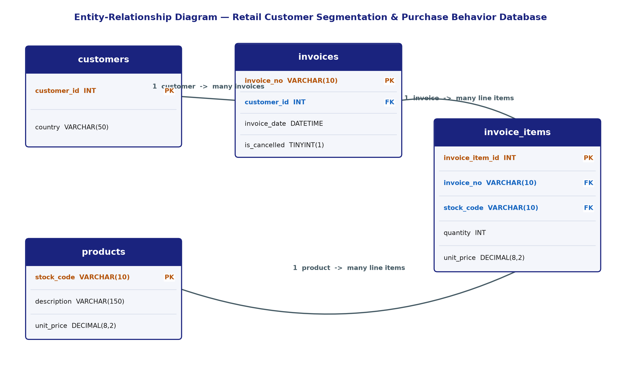
From one flat file to four related tables
2
Speaker: Nicka
300
207
invoices (271 completed)
customers
1,597
5,129
products
order lines
Cleaning (CP1): removed 5,268 duplicates, 2,910 non-merchandise codes, 1,047 invalid prices; kept real cancellations (“C” invoices).
Notes:
Show the ERD: customers 1→many invoices, invoices 1→many invoice_items, products 1→many invoice_items. Built in MySQL via phpMyAdmin (retail_customer_analytics). Point to the 4 cleaned tables and why normalizing helps (questions cut across customers, orders and products).

Slide 4
Three SQL findings from the database
2
Speaker: Nicka
84.9%
3 groups
9.7%
of completed revenue comes from the UK (£90,181 of £106,186)
High-Value, Repeat and One-Time customers from spend + order count
of invoices cancelled (29 of 300); one big order can distort the product list
Query 3 — revenue by country
Query 7 — segmentation
Query 8 — cancellations
Notes:
Open phpMyAdmin if asked to demo a query live (Query 3 or 7). Be ready to explain GROUP BY and the JOIN in Query 5/6. UK share computed from the 271 completed invoices; guest checkouts (11 invoices, £11.8K) have no country, so the country chart sums to less than total revenue.

Slide 5
Few bulk orders inflate the averages
3
Speaker: Jennilyn
11.6 vs 3
mean vs median units per line
£21.01 vs £10.20
mean vs median line total
2,880
largest single-line quantity
Plan stock from the median; treat bulk orders separately.
Notes:
Cues: right-skewed distribution; mean > median > mode; std dev (58.3) bigger than the mean. Source: Checkpoint 2 workbook, Descriptive Statistics sheet. Be ready to explain mean vs median and why skew matters for inventory.

Slide 6
Basket size matters; price barely does
3
Speaker: Jennilyn
r = −0.057
r = 0.691
R² = 0.478
Quantity vs unit price: no real relationship
Items per invoice vs invoice value: moderately strong
Simple regression (CP2): 47.8% of invoice value explained
Invoice Value = 217.49 + 9.35 × Items per Invoice
p < 0.0001, n = 271 invoices. Limit: a single predictor; the intercept is inflated by a few bulk orders. Trend forecast not reliable (R² = 0.047, p = 0.31) → we extend to a multiple regression next.
Notes:
Be ready to define Pearson r, R², and the p-value. Note: "items per invoice" = number of distinct product lines, not units. In the CP2 sheet the cell labelled "Standard Error (slope)" shows 484.56, which is the model standard error — the slope SE is 0.596; correct this label before the defense if you reuse that sheet.

Slide 7
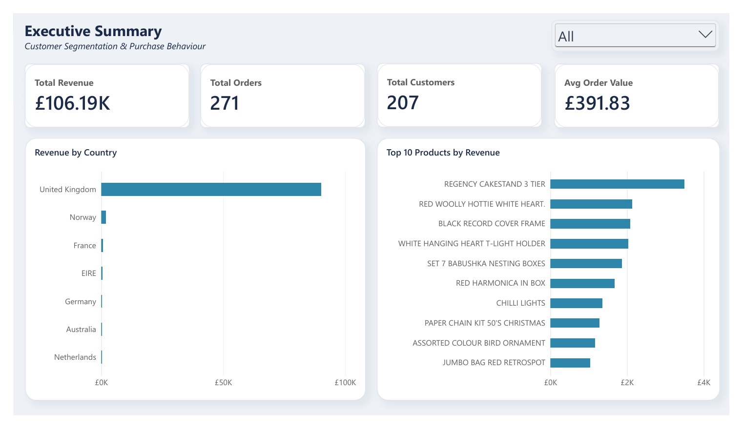
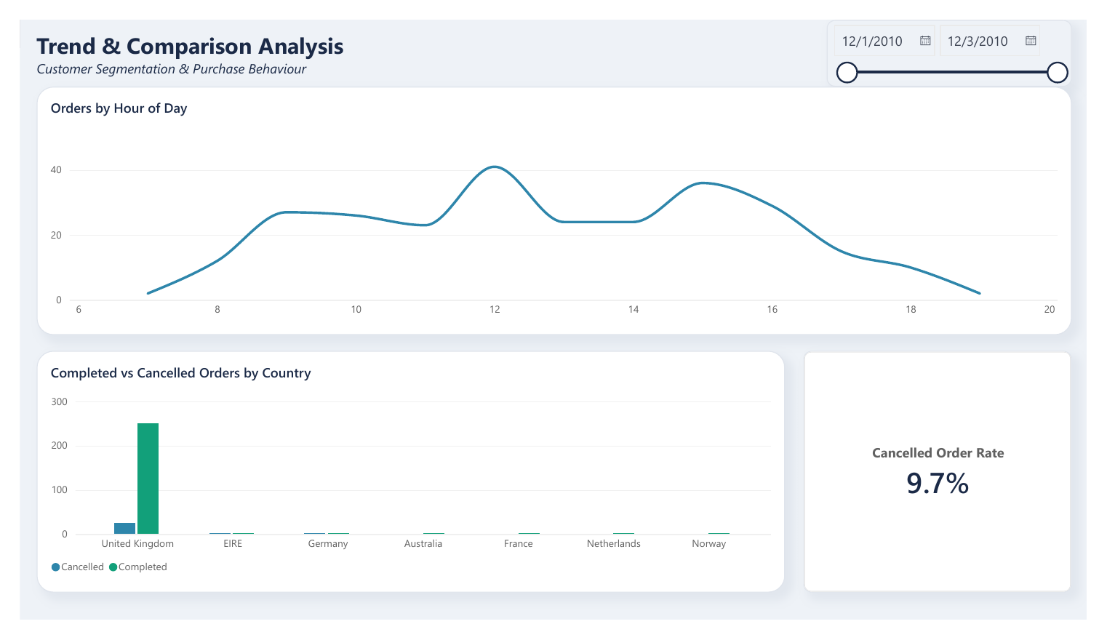
Live demo: overview and trends
4
Speaker: Jeziel
Page 1 — Executive Summary: £106.19K revenue • 271 orders • 207 customers • £391.83 avg order
Page 2 — Trends: orders by hour, completed vs cancelled by country, 9.7% cancel rate
Notes:
Open Customer Segmentation Dashboard.pbix (or the published link). Demo plan: (1) Page 1 – click a country in the slicer and show the cards and top-10 products react; clear it. (2) Page 2 – drag the date range and show orders by hour change; point to the 9.7% cancelled-order rate. Practise this twice. Expected values: £106,185.83 revenue, 271 orders, 207 customers, £391.83 AOV.

Slide 8
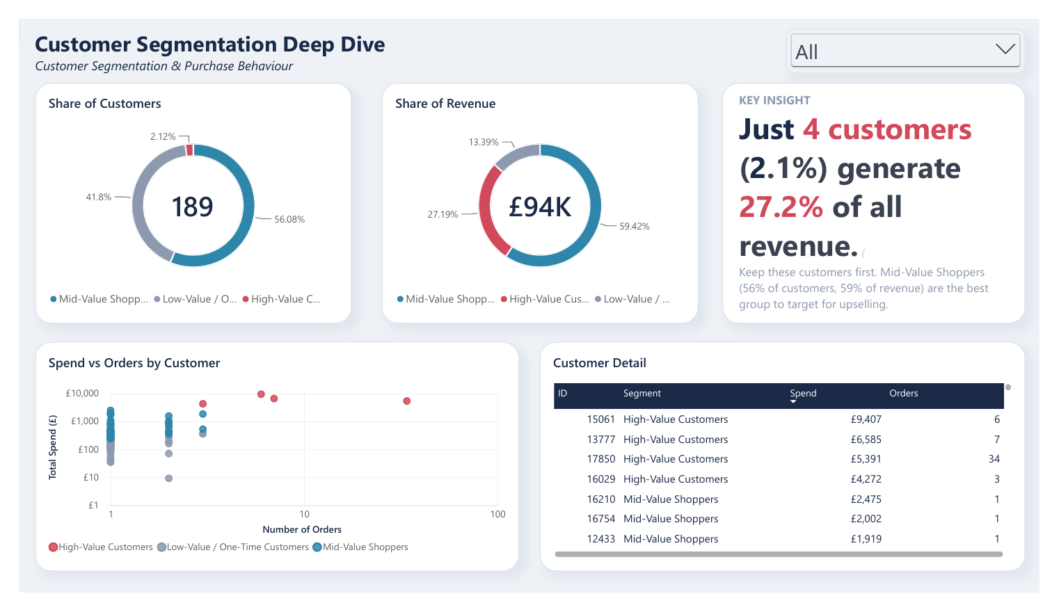
Segmentation: 4 customers = 27% of revenue
4
Speaker: Jeziel
K-Means, k = 3, on 189 customers (log-scaled spend, orders, AOV). Only ~3 days of data → Mid vs Low reflects spend per order, not loyalty.
Notes:
LIVE: click the Segment slicer (High-Value) and show the customer detail table filter; use drill-through if set up. Be ready to explain K-Means, why k = 3 (silhouette: k=2 0.553, k=3 0.437, k=4 0.487, k=5 0.463; k = 3 chosen as the smallest giving actionable groups), and why spend was log-transformed.

Slide 9
Multiple regression explains 80% of value
5
Speaker: Jennilyn
Value = 52.65 + 7.20 × Lines + 0.946 × Quantity
0.802
0.800
R²
adjusted R²
£299
542
standard error
F (p < 0.0001)
Y = invoice value (£); X1 = lines per invoice; X2 = total units. n = 271 completed invoices. Both predictors p < 0.0001.
Notes:
Excel workbook: Checkpoint 4 - Predictive Model.xlsx (Regression sheet = LINEST / ToolPak-style output). Be ready to explain: what each coefficient means holding the other constant; R² vs adjusted R²; why average price was left out (ΔR² = 0.0009, p = 0.26); the F-test.

Slide 10
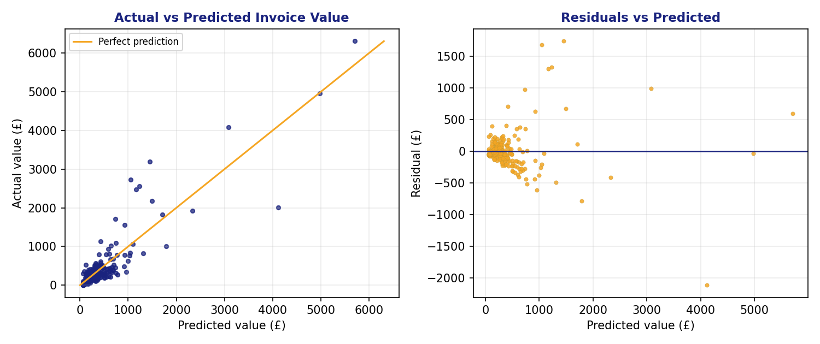
Predictions — and how far off they can be
5
Speaker: Jennilyn
Scenario | Lines | Units | Pred.
Small basket | 3 | 30 | £102.64
Typical (median) basket | 11 | 106 | £232.15
Large basket | 30 | 400 | £647.13
Typical + 5 extra lines | 16 | 106 | £268.16
Typical miss: £152 (mean absolute error, 39% of mean invoice). Approx. range ±£586.
Residuals fan out at higher values, and 13 of 271 invoices (4.8%) miss by more than 2 standard errors — use the model to compare scenarios, not to quote exact invoice totals.
Notes:
Live calculator: Predictions sheet in the workbook — change the blue cells (lines, units) and show the prediction update. Limits to be ready for: only 3 days of data; quantity is partly built into invoice value (value = quantity × price); outliers up to £6,308 vs median £248.

Slide 11
What the model tells us
5
Speaker: Jennilyn
+£7.20
+£0.95
≈ £0
per extra product line (units held constant)
per extra unit on an invoice (lines held constant)
added by average unit price
Lines coefficient 7.20, p < 0.0001
Quantity coefficient 0.946, p < 0.0001
R² gain 0.0009; p = 0.26
From the dashboard segments: 4 High-Value customers (2.1%) generate 27.2% of revenue; Mid-Value shoppers (56.1% of customers) generate 59.4%.
Notes:
Be ready to explain each coefficient (holding the other predictor constant), the p-values, and why average price was left out of the final model.

Slide 12
Model assumptions and limitations
5
Speaker: Jennilyn
3 days
±£586
of data (1–3 Dec 2010), one retailer, 271 invoices — re-fit before using elsewhere
approximate prediction range around any single invoice
Built-in link
4.8%
invoice value = quantity × price, so quantity is partly mechanical as a predictor
of invoices are outliers (residual > 2 SE); max £6,308 vs median £248
Notes:
Also mention: predictors are not collinear (r = 0.27, VIF ≈ 1.08); trend-based forecasting was rejected because CP2 trend R² = 0.047 (p = 0.31). A longer window (source data runs to 2011-12-09) would allow a real trend model.

Slide 13
Ethics, privacy and governance
6
Speaker: Nicka
Privacy
Ethical issues
Numeric CustomerID only — no names or addresses. 24.9% of raw rows are guest checkouts.
Segments could be used to treat customers differently. Who is missing from a 3-day, UK-heavy sample?
Governance
Regulation
Public CC BY 4.0 dataset. Who owns it, who may use it, how is it documented and reviewed?
RA 10173 (Data Privacy Act of 2012); GDPR concept — lawful basis, minimisation, profiling.
Notes:
Be ready to explain what “personal data” means under RA 10173 and why a numeric CustomerID combined with purchase history can still identify a person.

Slide 14
Open defense / Q&A
Thank you — we welcome your questions.
Notes:
Q&A PREP — every member should be able to answer ANY of these: 1) Why k = 3 and not 2? (silhouette 0.553 vs 0.437; k = 3 gives actionable groups). 2) Why log-transform spend? (heavy right skew). 3) What does R² = 0.80 mean — and its limits? 4) Why is average price not in the model? 5) Why not a time-trend forecast? (3 days, R² = 0.047, p = 0.31). 6) Why are guest customers excluded from segmentation? (no CustomerID; 18 customers had no completed order). 7) What is a JOIN / GROUP BY — walk through Query 5 or 3. 8) What does the 9.7% cancellation rate tell the business? 9) Which part of the ethics reflection would you act on first? 10) What would you do with the full year of data?

